Slide 1


Envisioning your Teams application

Slide 2
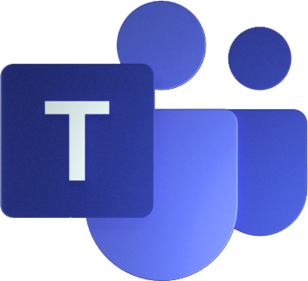
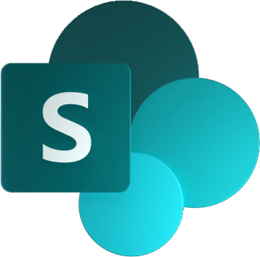

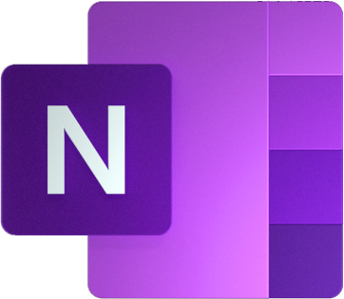




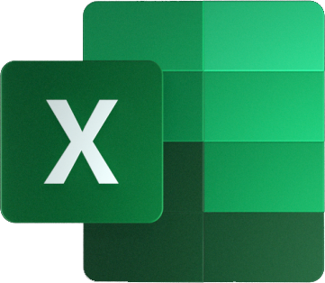
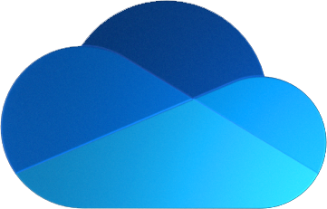
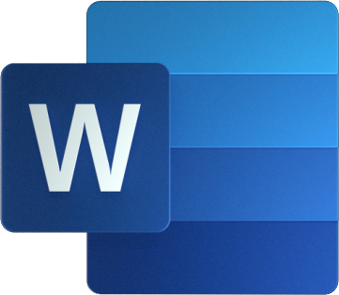


Teams Architecture
Microsoft Teams Clients
Electron (Windows, MacOS, Linux)
Web
iOS
Android
Teams Services
Files, Web pages Compliant file storage
Office
OneNote
Planner
Stream
To Do
Calendar
Compliant message storage
Microsoft 365 Services
Microsoft Azure
Azure Active Directory
Notes:
Teams clients – which include a desktop app, web app, and mobile app – run over not just Teams back-end services but also services all across Microsoft 365. Teams stitches them all together into a unified user experience.
Microsoft Azure AD is the identity system that’s common to all these services; without a common identity system, it would be difficult to provide a seamless and secure user experience.

Slide 3





Teams Application Architecture
Microsoft Teams Clients
Electron (Windows, MacOS, Linux)
Web
iOS
Android
Your Application
Tabs
Bots
Messaging Extensions
Connectors
Task Modules etc.
manifest.json
Teams Services
Files, Web pages Compliant file storage
Office
OneNote
Planner
Stream
To Do
Calendar
Compliant message storage
Microsoft 365 Services
Microsoft Azure
Azure Active Directory
Notes:
Your app doesn’t run in Teams; it just appears in the Teams UI.
(CLICK to show the manifest file which tells Teams how to display your app)

Slide 4

Teams Application Architecture
Microsoft Teams Clients
Electron (Windows, MacOS, Linux)
Web
iOS
Android
Your Application
Tabs
Bots
Messaging Extensions
Connectors
Task Modules etc.
manifest.json
Tabs: Teams JS SDK
Microsoft Graph
Adaptive Card actions
Bots, Msg Ext: Azure Bot SDK
Teams Services
Files, Web pages Compliant file storage
Office
OneNote
Planner
Stream
To Do
Calendar
Compliant message storage
Microsoft 365 Services
Microsoft Azure
Azure Active Directory
Notes:
Your app can also make use of all those underlying services!
The API that makes all that data available is called the Microsoft Graph.

Slide 5









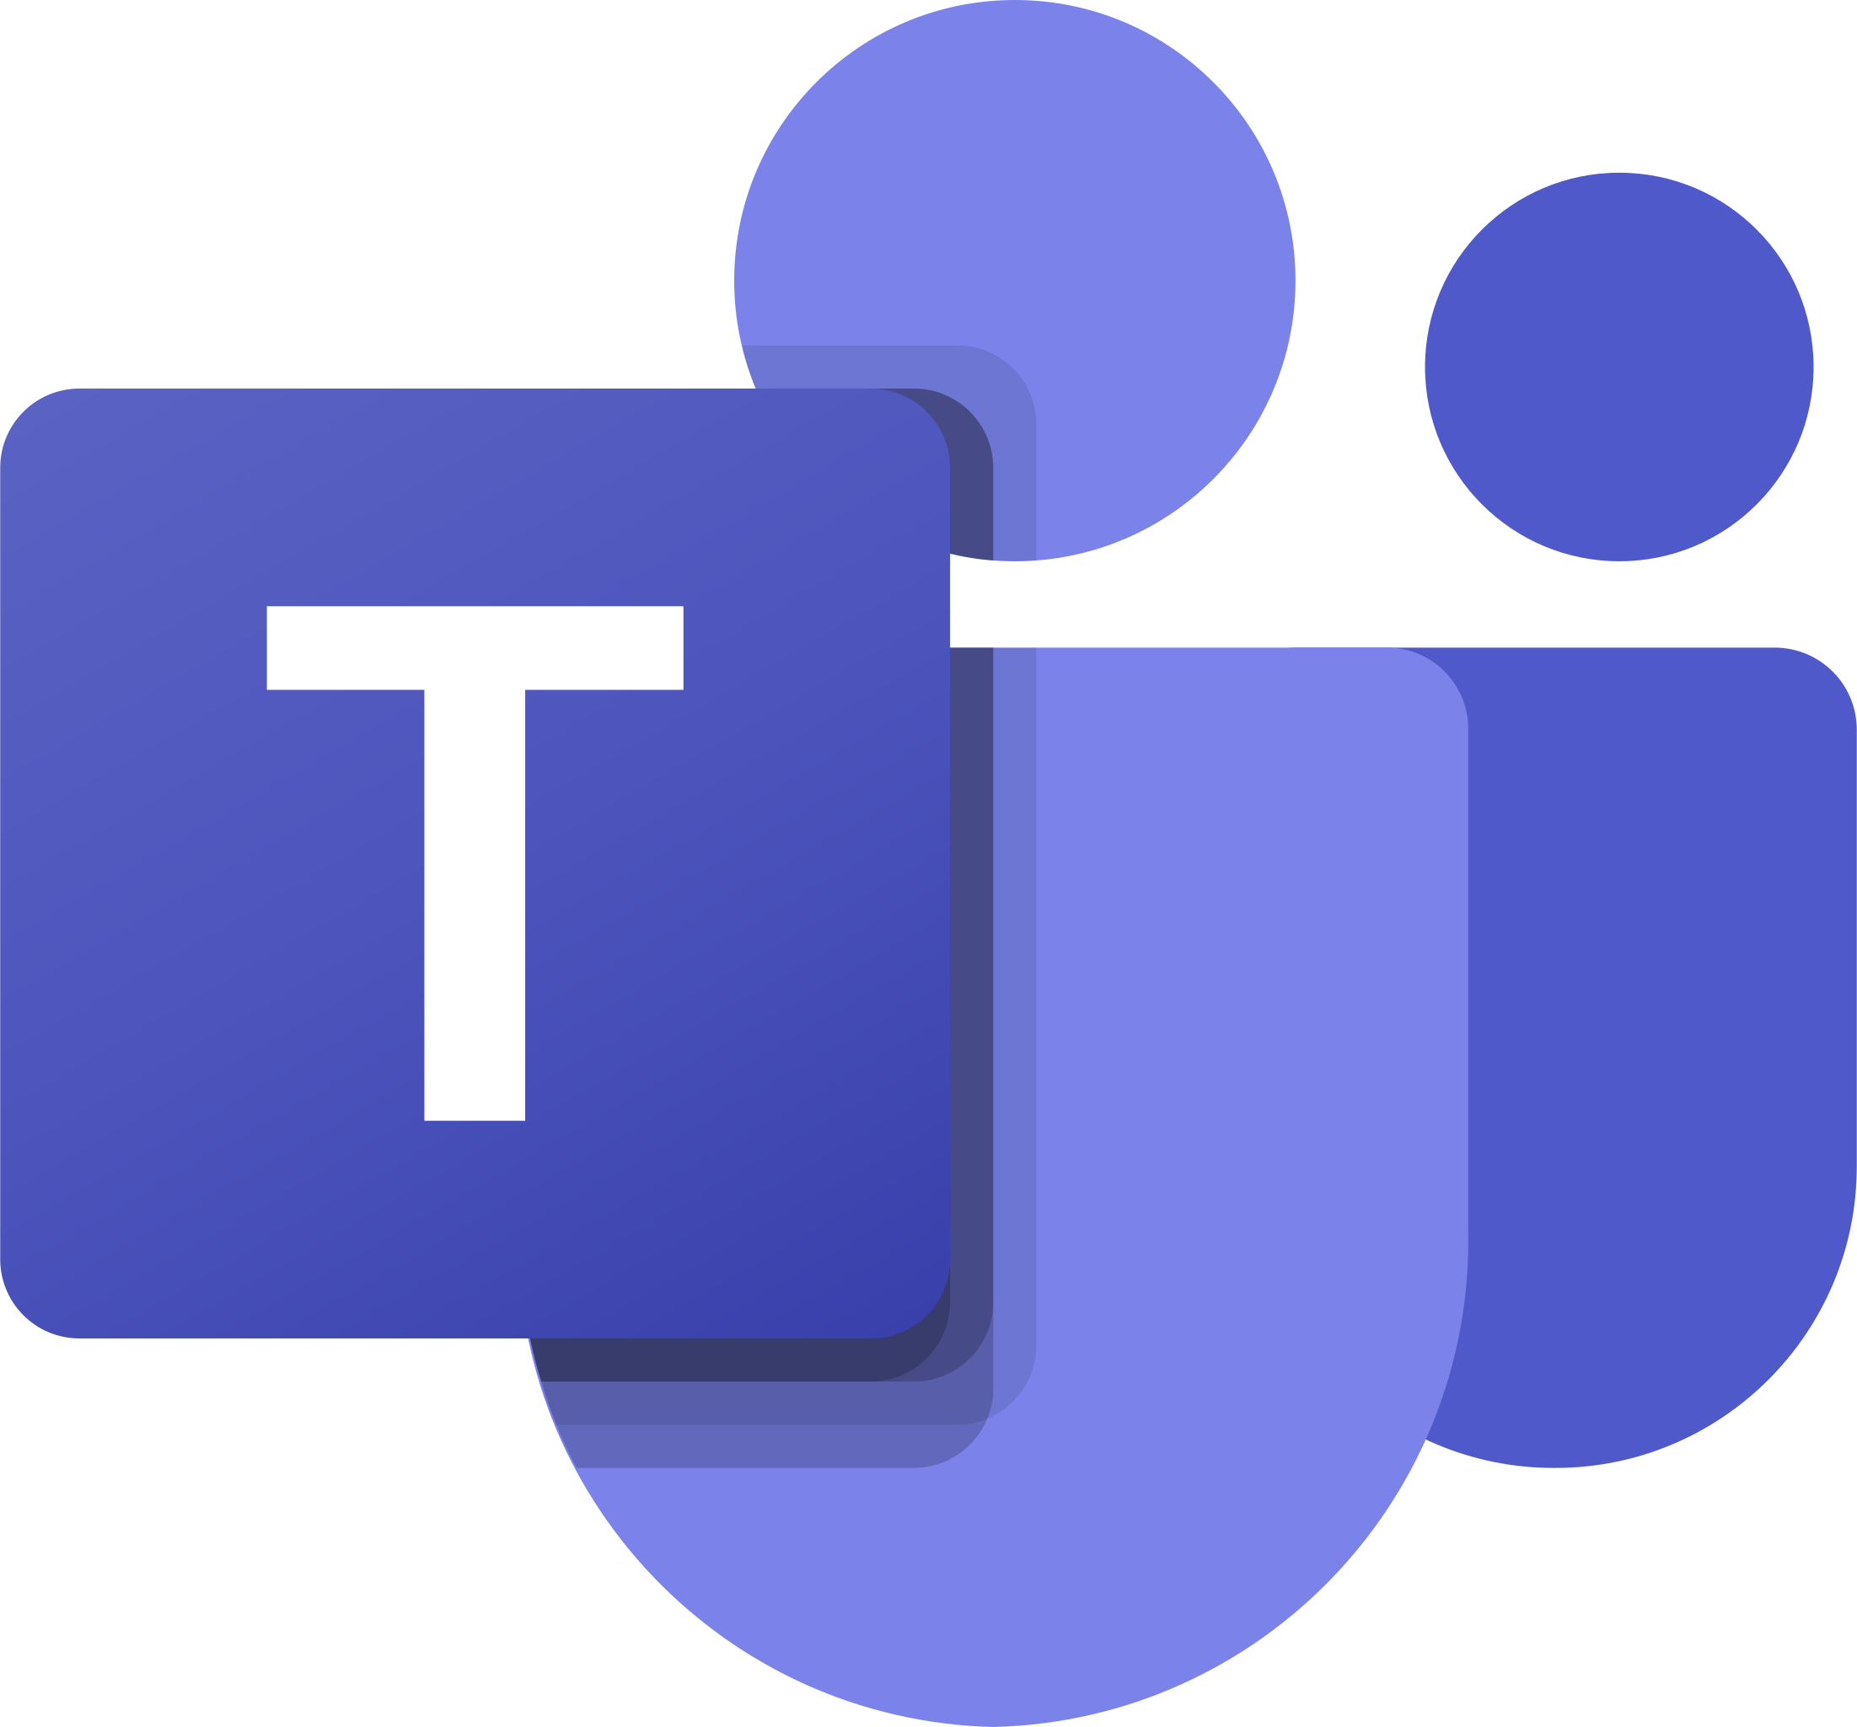
Teams apps add capabilities to Microsoft Teams
Teams apps run anywhere but Teams
you supply web pages, web services, and make API calls
run anywhere on the Internet
use any application stack
Tabs
Bots
Surface rich content as well as SharePoint Framework* based solutions
Help users get tasks done in conversations
Messaging Extensions
Connectors
App Package defines the app
Allow users to query and share rich cards in conversations
Post rich updates to channels
manifest.json
.zip
Dialogs
Adaptive Cards
Interact with users individually, even in a group setting (formerly called “Task Modules”)
Interactive content in chats and dialogs
Upload for yourself or a Team you own
Publish to enterprise app catalog of
Publish in the Teams store
YOU CAN
Notes:
The left side of the slide shows the Teams app “capabilities”.
Teams apps don’t actually run in Teams! They just expose web pages and web services, which could be anywhere on the Internet.
Tabs, as well as cofnguration pages and dialogs, are just web pages
Bots and Messaging Extensions are web services that communicate with the Azure Bot Service
Dialogs are invoked using an API
Adaptive cards can be used in Bots, Messaging extensions, and Dialogs, and are just JSON structures
All standard stuff – though Microsoft SDK’s make it easier.
A Teams app package is a zip file containing a file called manifest.json, plus a couple of icons. The manifest.json file contains the locations of the web pages, the Bot ID for bots and messaging extensions, and other information Teams needs to cleverly stitch your application into the Teams user interface.

Slide 6
Teams application scopes
Teams Scope - your app in a Teams channel
Group Conversations/Meetings – your app in a group or 1:1 chat
Personal Scope – your app accessed by individual users
Notes:
Teams apps can run in 3 application scopes.
Teams channels are part of Teams, which have a specific membership. Your app is interacting with the members of the Team.
Group conversations – which include meetings – have an ad-hoc membership but still your app is interacting with multiple users.
Personal scope apps are selected in the left navigation of Teams. This is where your app can work 1:1 with users; this is a good place to provide per-user summaries or other information that will be different for each user/

Slide 7
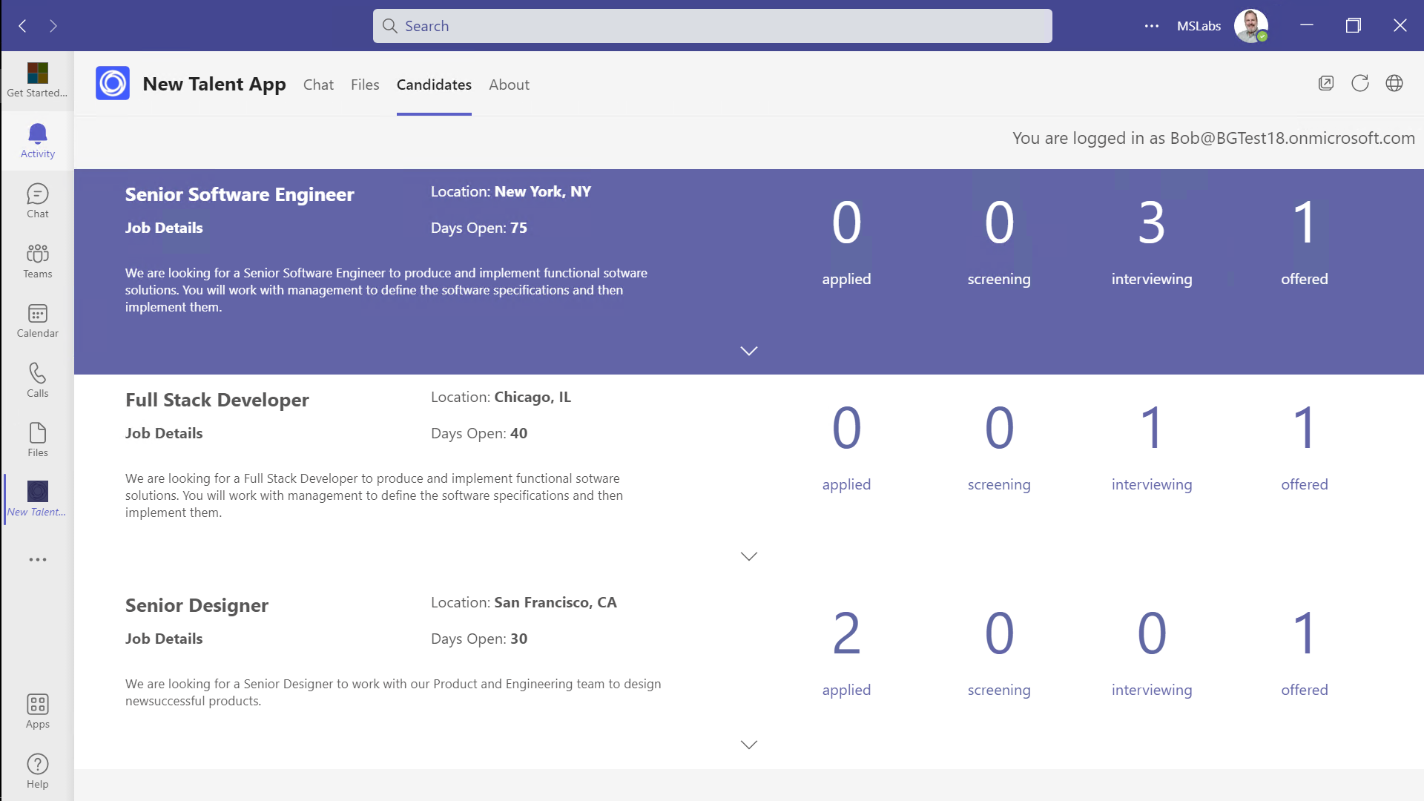
Personal Tabs
A visual user interface that can be navigated and pinned via Teams’ sidebar
This is the personal view of your app – use it to show summaries, settings, specific to this user
Implement as a web page that runs in an IFrame
Discoverability
Employee Experience
User Engagement
Available in Teams side navigation – easier than a bookmark or app launcher tile
Employees can find apps in Teams app store; "featured" by your org or shared by colleagues
Use Teams app policies to auto-install and pin apps for employees who need it
Users and admins can pin apps to the side bar, increasing app usage
All solutions in one place
(preview) Use in Outlook and Office.com as well as in Teams
Notes:
Suggested demo: Show the Northwind Orders personal tab; notice how it shows the user his or her own orders.
This is a typical use of a personal tab – to show users their own personal information.

Slide 8
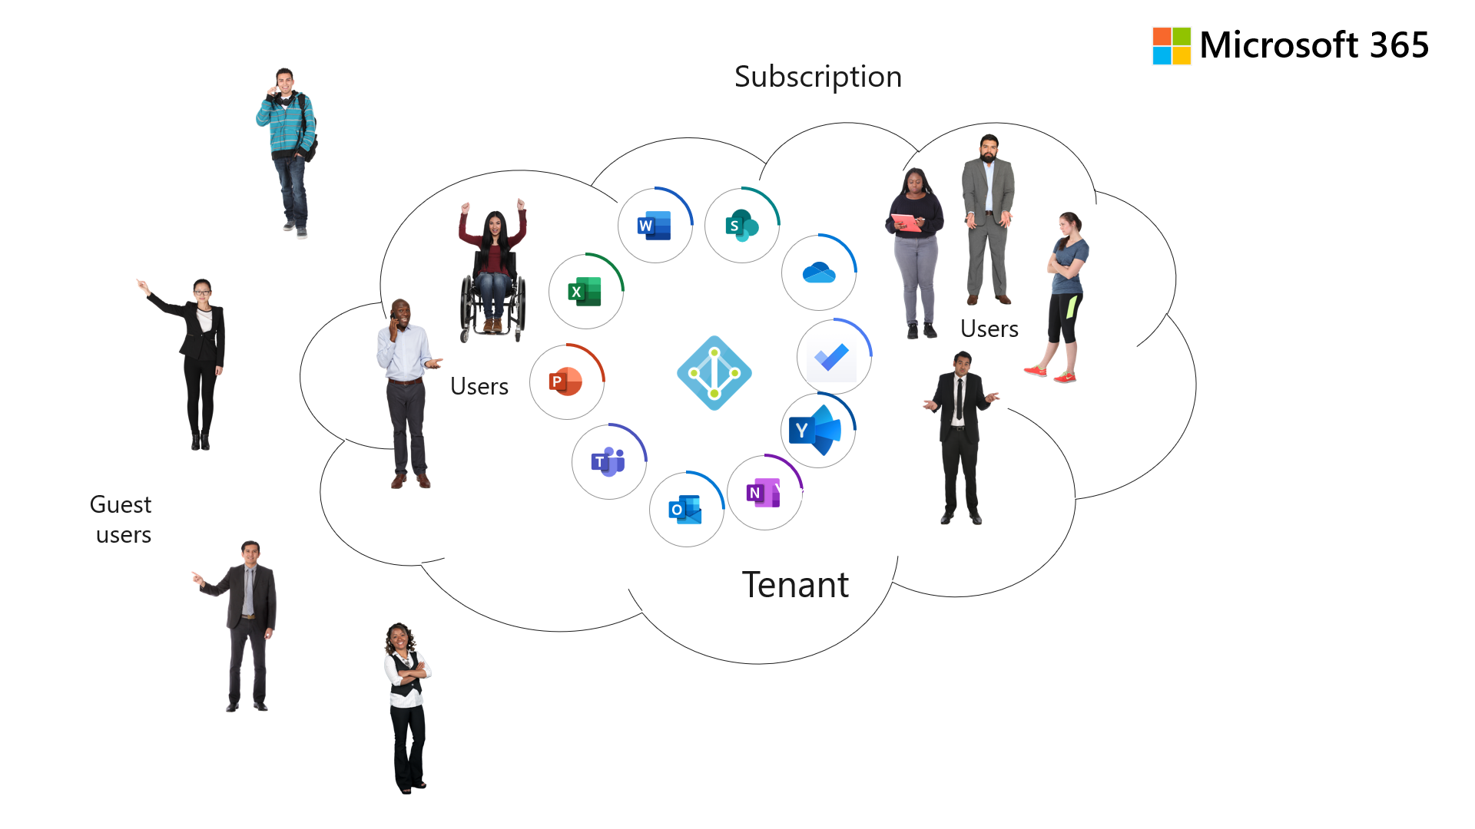
Azure AD Single Sign-On
Users have a single identity across Microsoft 365 and your app
Users seamlessly sign onto your app within Teams, even as they move to new devices
Employee Experience
Security
No extra username and login information to manage
Conforms to each customer’s policies (MFA, conditional access, etc.)
App can access user’s Microsoft 365 content and integrate into application work streams
User Engagement
App can enforce access from approved Teams clients, devices
Collaborators don’t need to navigate a second set of users to share their work
Seamless login across devices
Accounts are managed by IT using established processes
Commercial
Required for Teams App store monetization
Required for Microsoft 365 App Compliance Program
App can write to Teams activity feed to notify users and draw them back to the app
Notes:
Suggested demo: Show the solution to B-02 and how the pop-up login works. Contrast with the SSO solution found in the other labs.
Azure AD SSO is a feature that users don’t see – they just use the app without having to log in again

Slide 9
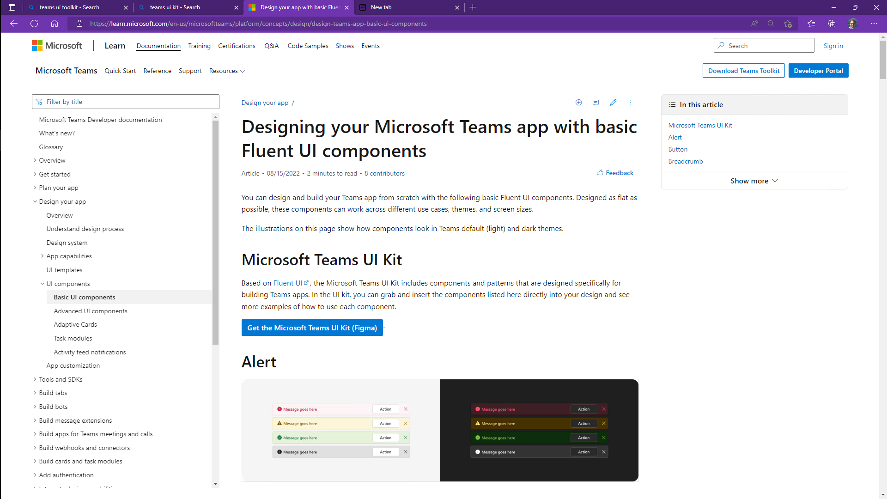
Teams UI Kit
The Teams UI Kit provides Figma UI guidelines and React components that help your app appear consistent with Microsoft Teams
Teams JavaScript API allows apps to follow Teams theme settings
Accessibility
App conforms to user’s choice of light, dark, or high contrast UI
User Engagement
Apps are consistent with Teams UI guidelines
Users are already comfortable with app’s look and feel
Notes:
Suggested demo: Browse to the Teams UI Kit http://aka.ms/teams-ui-kit and drill into the Figma files and look around.
Microsoft has published Teams UI guidelines in Figma, along with a collection of React components.
There is also a community project called HtwoO that provides CSS styles and web controls - https://aka.ms/htwoo

Slide 10
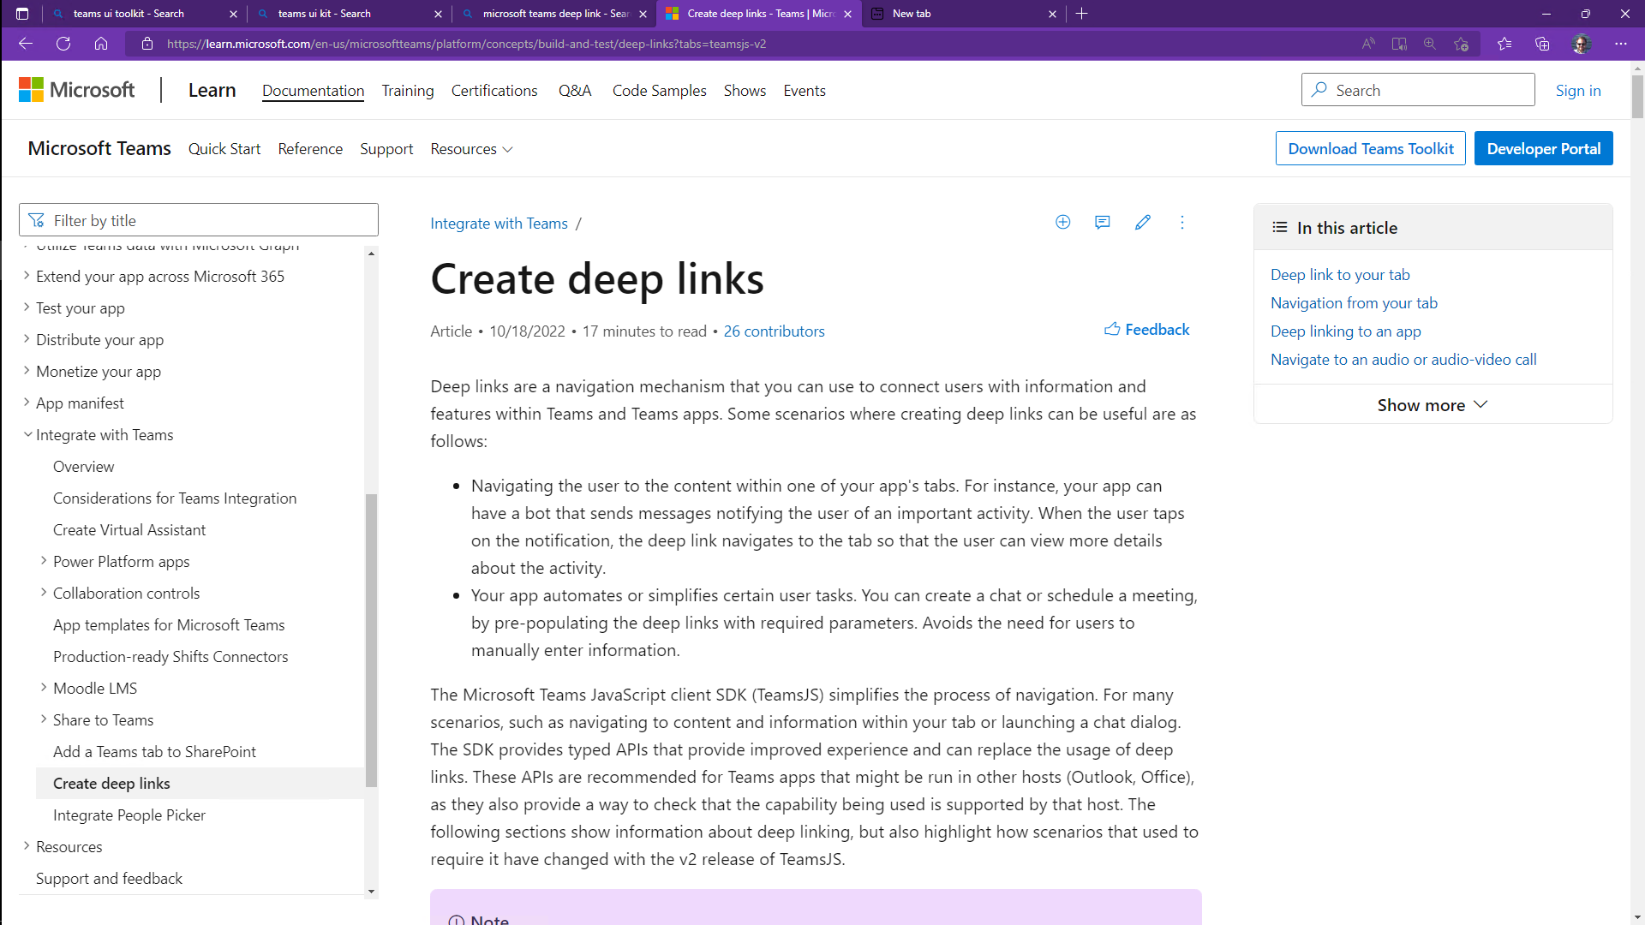
Deep Linking
Your app can create links to itself in context within Teams
Use these in notifications and messages in and outside of Teams
Send notifications that bring users back into your app
User Engagement
Connect users to work streams within your app along with related collaboration
Discoverability
Users bring colleagues into the app via simple links
External apps and pages can link into your app
Users are prompted to install the app if needed
Notes:
Suggested demo: Show the completed solution for the Deep Linking lab. Copy the deep link; close Teams and open the link to go all the way into an order within the app

Slide 11
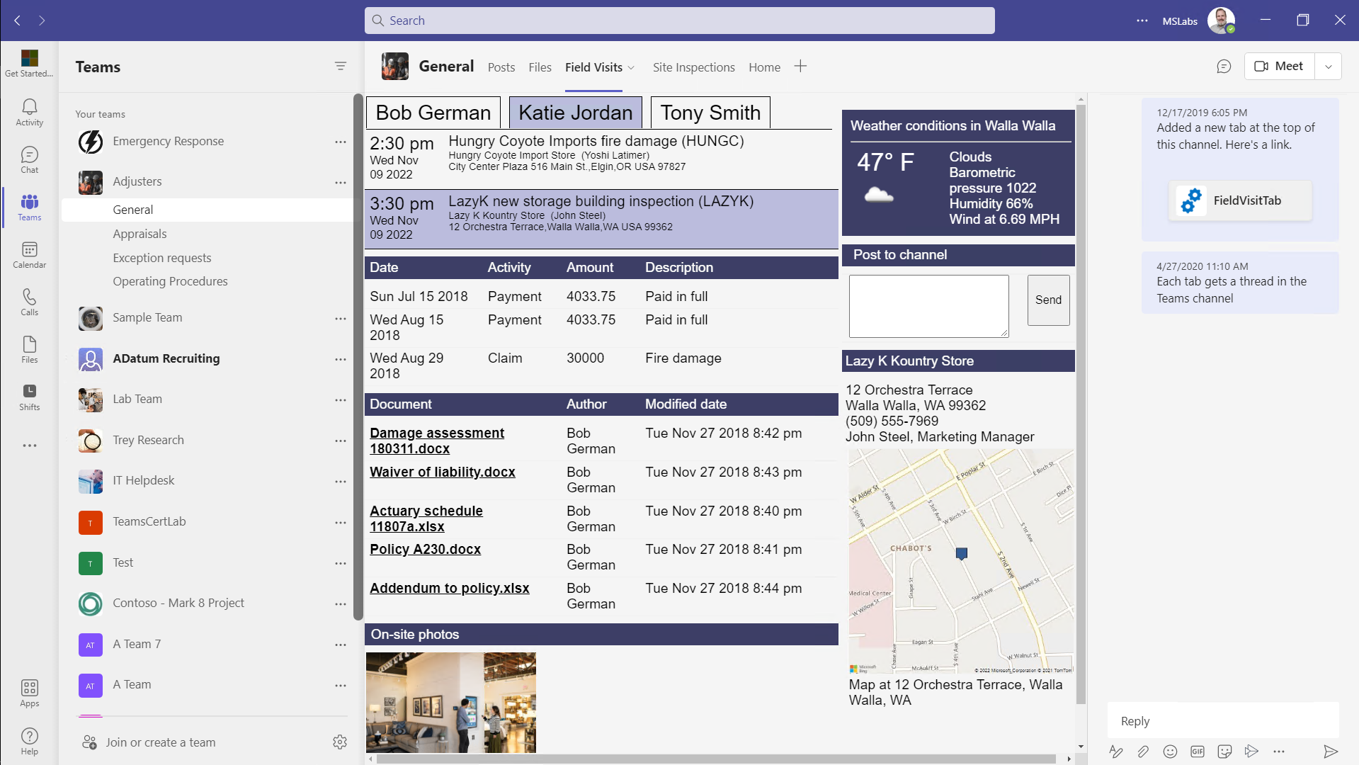
Configurable Tabs
Your tab is available in collaborative environments such as group chats and Teams channels
Users can configure your tab to display information that’s relevant to the chat or channel topic
Collaboration
Discoverability
Admins can Include apps in Team Templates so they’re automatically installed in new Teams
Users can configure the tab to show relevant information
Once the tab is configured, it brings users directly to relevant information
Users can chat alongside the application
New tabs are announced in the conversation, drawing users in
Notes:
Suggested demo: Create a Beverages team and add a Beverages tab from the Northwind Orders app

Slide 12
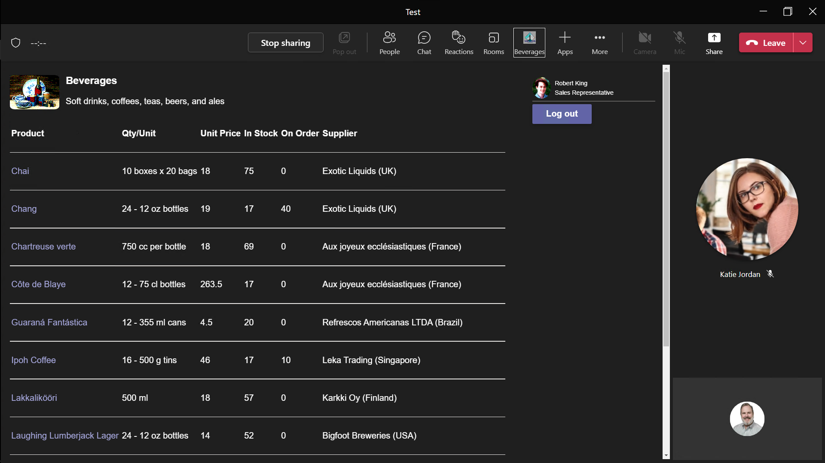
Meeting Apps
Tabs and bots are available before, during, after a meeting
Allow users to use the app collaboratively as they meet
Collaboration
Discoverability
Organizer installs the app for everyone in the meeting
Users can configure shared tabs and interact with chat bots
Users can meet and chat alongside the application
Provide information and capture outcomes during meetings
Notes:
Suggested demo: Show the completed Meeting Apps lab

Slide 13
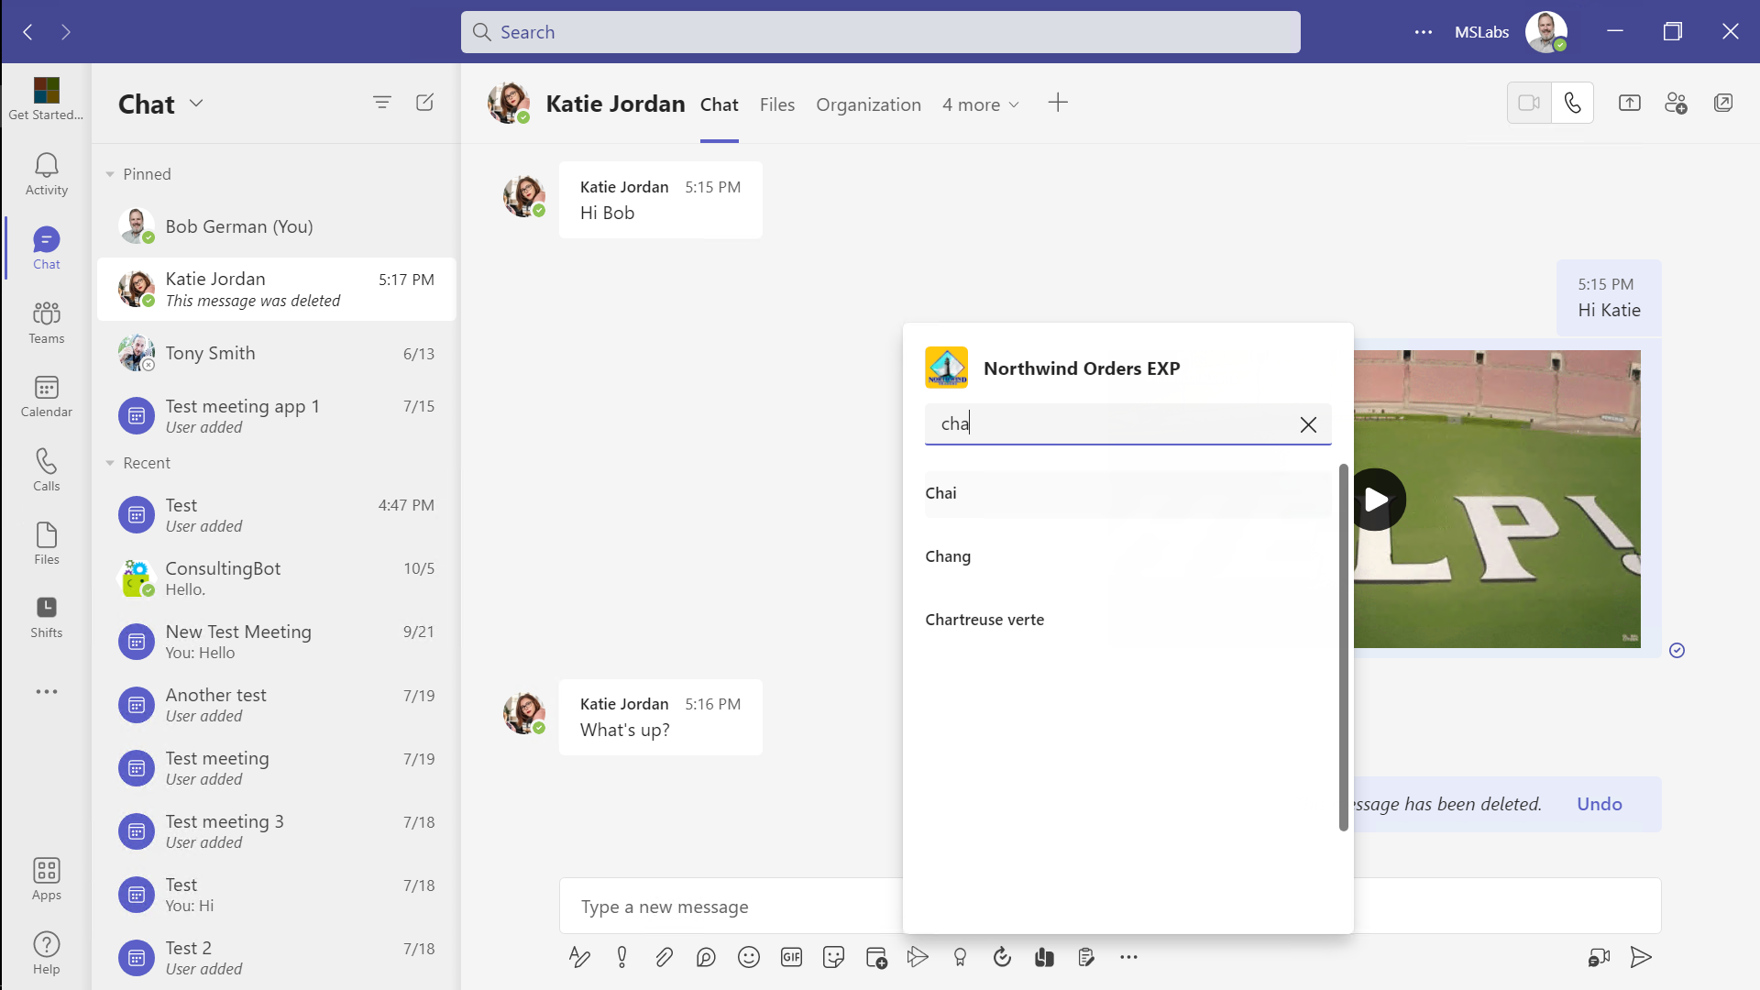
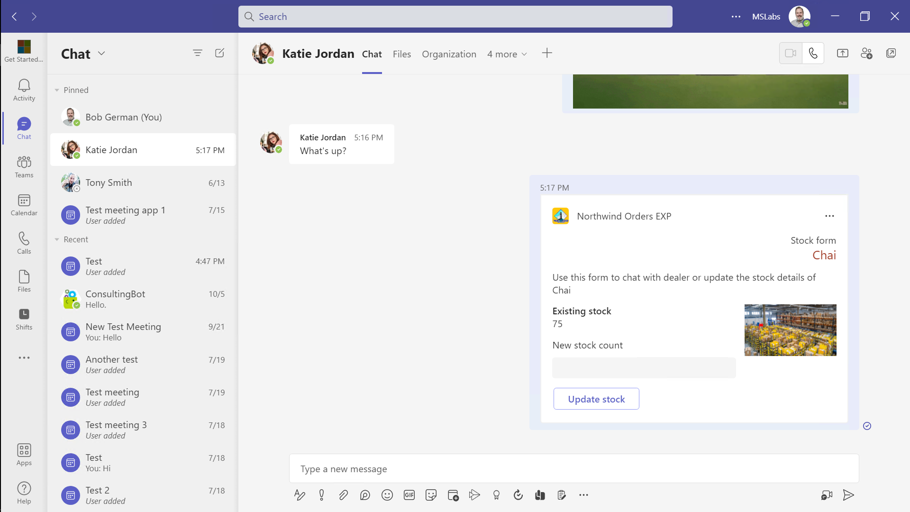
Message Extensions
Extend the menus and commands in Teams
Allow users to include your app in conversation through interactive Adaptive Cards
Collaboration
Employee Experience
Allow users to share and interact with information from your application
Remove copy-and paste hassles
Allow apps to display information when a link is shared in Teams
Streamline work allowing your app to interact inside of chat conversations
Notes:
Suggested demo: Show the completed Messaging Extension lab. Update the inventory using the adaptive card and then check it in the app.

Slide 14

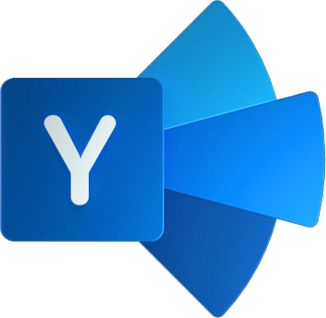
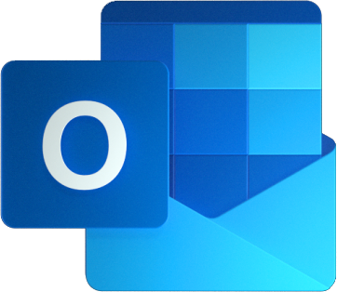

Anatomy of a Teams App
Azure AD
REST API
Teams Application
Microsoft 365 Data
Your app’s web pages in the Teams client
Teams JavaScript SDK
Microsoft Graph API
REST API
Web content; REST API
Your app’s web servers(s)
Azure Bot Framework
Microsoft Graph SDK
Bot Builder SDK
Message Extensions
Adaptive Card actions
Proactive Bots
Conversational bots
REST API
manifest.json
Notes:
A typical Teams app is served up by an ordinary web server, which serves up web pages to be displayed in tabs, dialogs, and configuration pages.
In addition, it typically provides a REST interface for use by the client apps. The client-side code authenticates itself to the app’s server using an Azure AD access token provided by the Teams JavaScript SDK; the web server validates this token using an Azure AD library.
When the app needs access to content in Teams or other parts of Microsoft 365, it uses the Microsoft Graph API. To call the Graph, it needs an Azure AD access token; the app uses the Oauth 2.0 On Behalf Of flow to swap the incoming access token for a new one that targets the Microsoft Graph.
This works well for many things, but sometimes Teams needs to provide real-time updates to the app, such as when a message extension is clicked or a conversational bot receives a message. This is provided by the Azure Bot Framework, which is well-suited to provide secure real-time messaging between the app and Microsoft Teams.

